Slide 1
AE Cloud 2 S5D9 Arduino Pin and Port Summary Document
By Michael Li (3/26/2019)

Slide 2
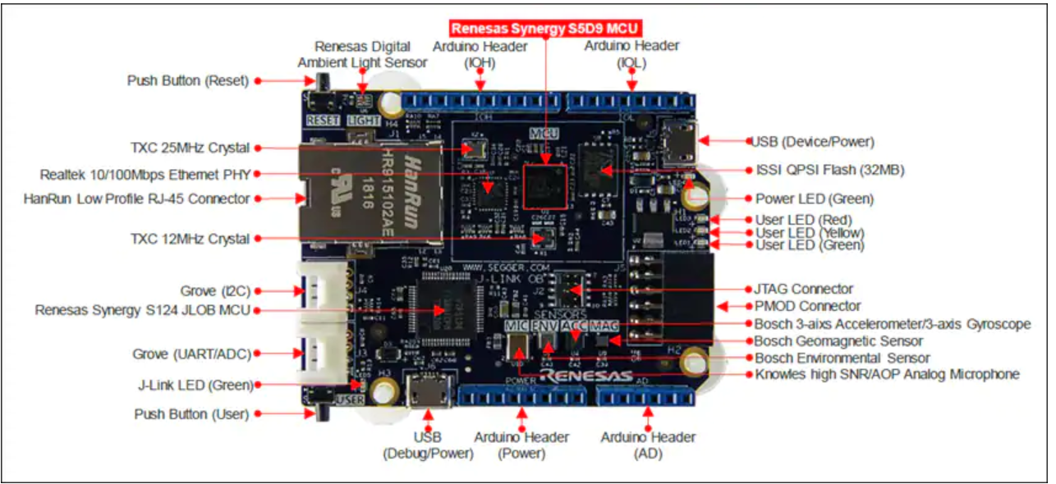
AE Cloud2 S5D9 Board with Arduino Header

Slide 3
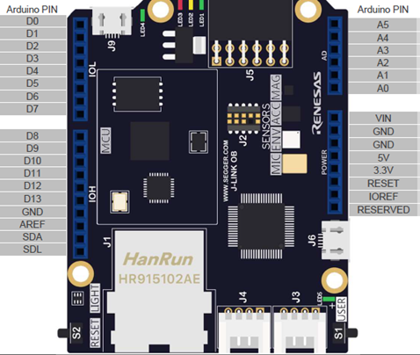
Arduino Header Map
Red, yellow, green LEDs
SPI PMOD Header J5
Note: AREF = 3.3V
I2C Grove Header J4
UART Grove Header J3

Slide 4
Pin Table
Arduino Shield Header
I2C Grove Header J4 (Wire 1)
Pin Number | S5D9 Pin # | Function
D0 | P6_14 | TX | Serial 0
D1 | P6_13 | RX
D2 | P6_12 | GPIO or SS2 (SPI0) | GPIO or SPI0
D3 | P6_11 | GPIO | GPIO
D4 | P6_9 | GPIO | GPIO
D5 | P6_2 | PMW | PMW
D6 | P1_2 | PMW | PMW
D7 | P1_13 | GPIO | GPIO
D8 | P1_11 | INT0 | INT0
D9 | P1_10 | INT1 | INT1
D10 | P1_7 | SS1 | SPI0 (SCI_SPI8)
D11 | P1_5 | MOSI
D12 | P1_4 | MISO
D13 | P1_6 | SCLK
 | GND | GND
 | 3.3V | 3.3V
A0 | P5_8 | ADC | ADC
A1 | P5_6 | TX | Serial 1
A2 | P5_5 | RX
A3 | P5_0 | ADC | ADC
A4 | P5_1 | SDA | Wire 0
A5 | P5_2 | SCL
D20/21/22 | P7_11/10/08 | RED/YELLOW/GREEN LEDs | LED
Pin Number | S5D9 Pin # | Function
1 | P1_0 | SCL
2 | P1_1 | SDA
UART Grove Header J3 (Serial 1)
Pin Number | S5D9 Pin # | Function
1 | P5_5 | TX
2 | P5_6 | RX
6 pin SPI PMOD
SPI PMOD Header J5 (SPI 1)
Pin Number | S5D9 Pin # | Function
1 | P2_5 | SS1
2 | P2_3 | MOSI
3 | P2_2 | MISO
4 | P2_4 | SCLK
5 | GND | GND
6 | 3.3V | 3.3V
6 pin SPI PMOD
Pin Number | S5D9 Pin # | Function
7 | P4_9 | INT2 (IRQ6) ??
8 or D14 | P4_12 | GPIO
9 or D15 | P3_7 | GPIO
10 or D16 | P3_6 | GPIO

Slide 5
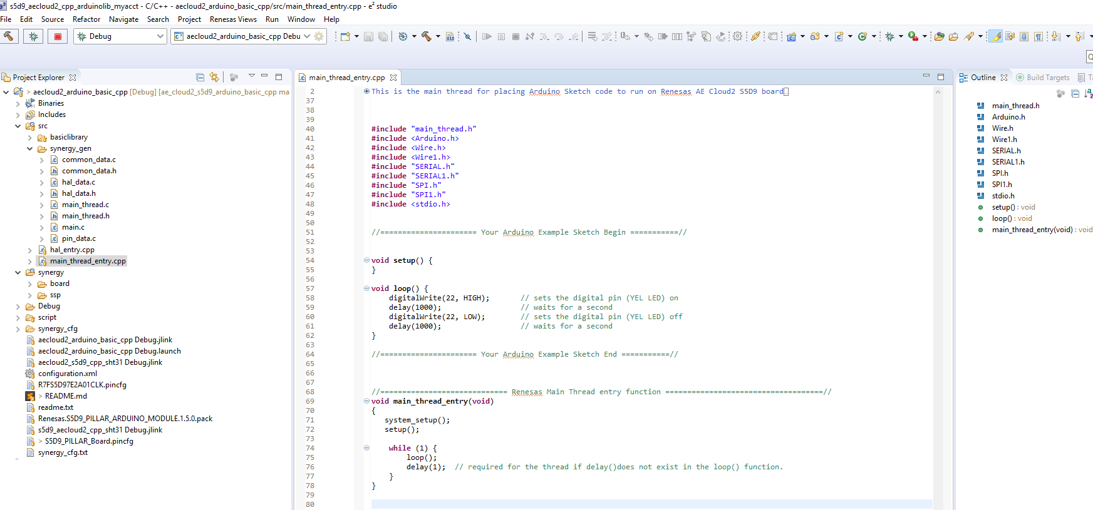
Project File: Main Thread File (Your Sketch here)
Support Libraries

